Slide 1
Module 4
Authentication and Authorization, Cloud Trial, Cloud Watch

Slide 2
IAM
IAM, or Identity and Access Management, is a framework of policies, processes, and technologies that enable organizations to manage digital identities and control access to resources.
Key components of IAM:
Identity Management
Access Management
Authentication
Authorization
Audit and Reporting
Notes:
IAM, or Identity and Access Management, is a framework of policies, processes, and technologies that enable organizations to manage digital identities and control access to resources. Ensuring that only authorized users have the appropriate access levels to systems, data, and applications.
Here's a brief overview of the key components of IAM:
Identity Management: Involves managing the creation, updating, and deletion of user identities, including employee, contractor, or customer profiles.
Access Management: Controls the permissions and access levels of users. Access is typically granted based on roles or policies, ensuring that users only access resources necessary for their tasks.
Authentication: Verifies the identity of users through methods like passwords, multi-factor authentication (MFA), biometrics, etc.
Authorization: Determines what an authenticated user is allowed to do within a system. For example, one user might have read-only access, while another has administrative rights.
Audit and Reporting: Tracks and logs user activities, helping to identify suspicious behavior and support compliance with regulations.

Slide 3
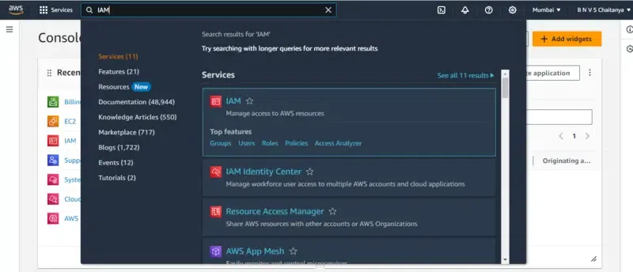
Steps to create IAM user
Step 1: Go to the Amazon web services Sign-In console. Create an AWS Free Tier Account.
Step 2: Try signing in with your root username and password
Step 3: Search in the search box entering "IAM user" as shown in the image.

Slide 4
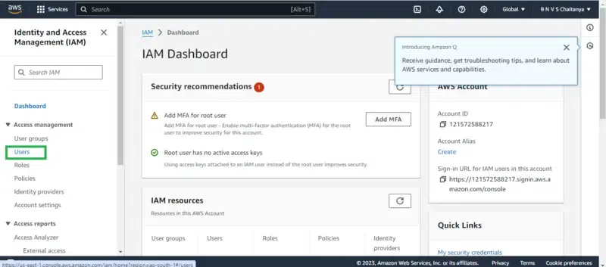
Step 4: After you enter the IAM user page, you can see the IAM dashboard then go to the "users" option by clicking on it.
In the user sections try creating a user by clicking on the "create user" button, now you will follow through with 3 phases for creating an IAM user.

Slide 5
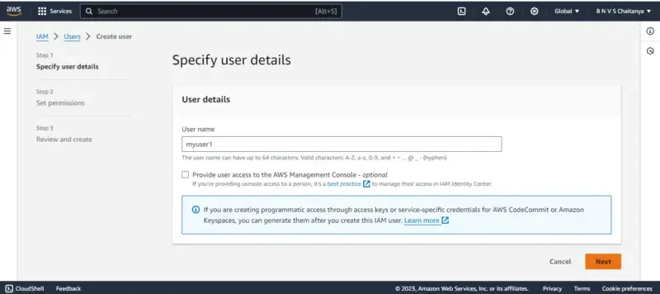
i. Specifying the user details
Provide the username that you would like to create as an IAM user
ii. Setup the permissions
Select the attach policies directly option, It's meant to assign the policies individually for the IAM user.

Slide 6
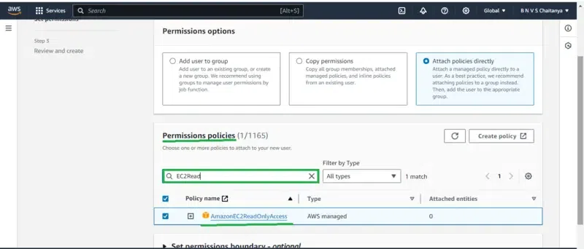
In the Permissions policies section go to the search box and enter EC2ReadOnly, you can see the policy name with AmazonEC2ReadOnly select it to provide this policy access to creating IAM user.
Similarly you can add on whatever permissions that you would like from the pre-created policies as per the requirement.
They will be a case in which we can't find the require based policies in that moment , you have to create policies as your own.

Slide 7
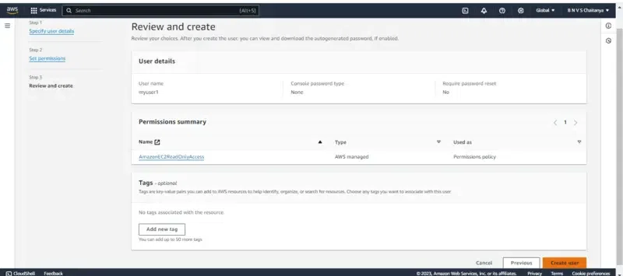
iii. Review and create
In this step you have to review the information that you provided, once verified then go for the create option.
Finally, the IAM user is been created and you can see it on the dashboard.

Slide 8
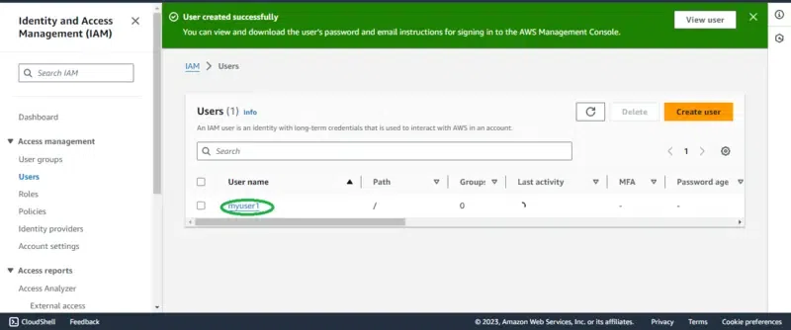
Note: Till now the user creation is done, the root user can anytime may delete the user or customize the permission policies as needed.

Slide 9
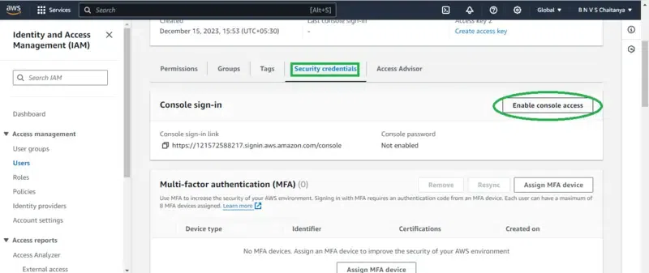
Creating the Password (Security)
Step 6: Now based on the mode of login we have to create a password or access Key as per the use case. If you need a web console login then try on setting the password or else create the access key.
Note: Here, we will go through web console access.
Step 7: Firstly Go to security credentials, In the console -sign-in section click on the enable console access button.

Slide 10
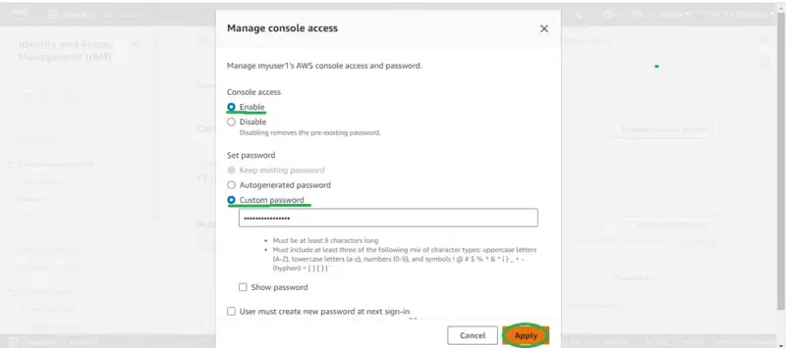
By clicking on the Enable console button you will be redirected to manage console login as shown in figure:
Choose the Enable option
Coming to the below password section we can set either the customized password that is directly set now or auto-generating and try on creating at the time of login.
Try Setting up the password as per instructions on including Alphabets, Special Characters, and Numbers.

Slide 11
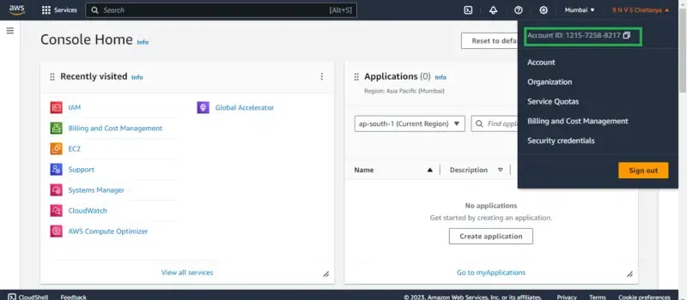
Step 9: Follow the instructions while setting the password once it is created click on 'Done' option.
Login with the IAM User
Step 10: For logging in with the IAM user we need 3 things:
1. AWS account ID, you can get the AWS account Id by clicking the root user account in the right corner similar to the figure highlighted below.

Slide 12
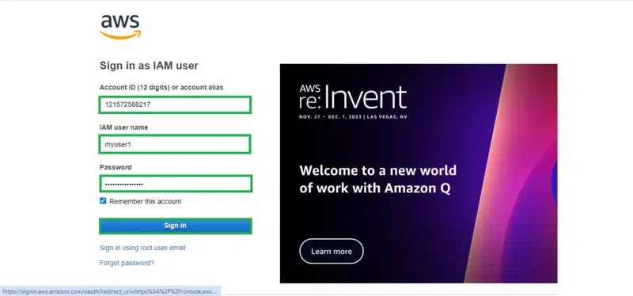
2. IAM username, The IAM user name that you created
3. Password, The password that you set for this IAM user
Fill in the asking details such as AWS account ID, IAM user, and Password from the sign-in portal going to the IAM user option:

Slide 13
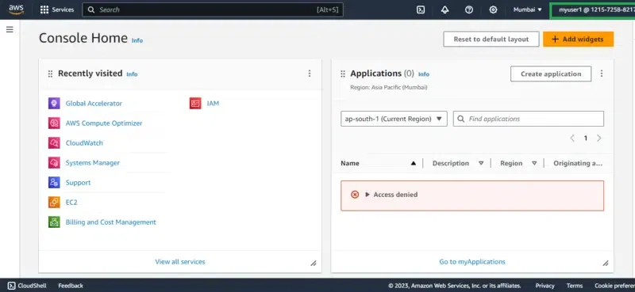
Once you log in successfully you can view the page as shown below, on top of the right corner you can see the IAM username with account ID:
If you reached to this final interface then you performed the creation and login with the IAM user successfully.

Slide 14
Authentication tools in AWS
Here are some primary AWS authentication tools and services:
AWS Identity and Access Management (IAM)
AWS Single Sign-On (SSO)
Amazon Cognito
AWS Security Token Service (STS)
AWS Organizations
Notes:
In AWS, authentication tools are services and features that help manage user identities, verify users' credentials, and control access to AWS resources. Here are some primary AWS authentication tools and services:
1. AWS Identity and Access Management (IAM)
AWS IAM is the core identity and access management service, enabling you to create and manage AWS users and groups, assign permissions, and control access to AWS resources.
Provides IAM users, groups, roles, and policies to manage permissions.
Supports Multi-Factor Authentication (MFA), requiring users to provide an additional verification code along with their password.
AWS Single Sign-On (SSO)
AWS SSO is a cloud-based service that allows users to access multiple AWS accounts and applications with a single set of login credentials.
Integrates with on-premises Active Directory and supports SSO for external applications like Microsoft 365 and Salesforce.
Allows users to use federated login from corporate directories.
3. Amazon Cognito
Amazon Cognito provides authentication, authorization, and user management for web and mobile applications.
Enables user sign-up, sign-in, and access control.
Supports OAuth, SAML, and OpenID Connect for social and enterprise identity providers, including Google, Facebook, and SAML-based identity providers.
4. AWS Security Token Service (STS)
AWS STS provides temporary security credentials for IAM users or federated users.
Supports assumed roles for temporary access to resources across different AWS accounts.
Useful for granting short-term access to AWS resources without exposing long-term credentials.
5. AWS Organizations
AWS Organizations helps manage and control multiple AWS accounts within a single organization.
Allows centralized management of IAM policies across accounts and helps implement best practices for access control.

Slide 15
Cloud Trial
In AWS, CloudTrail is the primary service for monitoring and logging account activity across AWS resources.
Some core concepts within CloudTrail:
Management Events
Data Events
Trails
Log File Integrity Validation
Notes:
In AWS, CloudTrail is the primary service for monitoring and logging account activity across AWS resources. It provides a detailed history of API calls made within your account, which is essential for security, auditing, and troubleshooting. Here’s a breakdown of some core concepts within CloudTrail:
1. Management Events
Management events provide information about administrative actions performed on AWS resources, such as creating, deleting, and modifying configurations.
Examples include IAM user creation, S3 bucket deletion, EC2 instance launch, etc.
Enabled by default on all trails in CloudTrail, management events help track high-level changes to your environment.
2. Data Events
Data events capture resource-level activities like S3 object-level actions (e.g., GetObject, PutObject) and Lambda function invocations.
Data events are typically high-volume, so they are not enabled by default; they need to be explicitly configured to capture specific actions on resources.
Useful for tracking sensitive data access and understanding detailed interactions with resources.
3. Trails
A Trail is a configuration within CloudTrail that enables logging and monitoring of events in one or more AWS regions.
Trails can be configured to log all regions or a specific region.
You can create multiple trails with different configurations, for example, one for global monitoring (across all regions) and another for detailed tracking of specific actions.
CloudTrail can store logs in an S3 bucket and send them to CloudWatch Logs for further analysis and alerting.
4. Log File Integrity Validation
CloudTrail provides an option for log file integrity validation to ensure that the log files are complete and unaltered after delivery.
Using SHA-256 hash and digital signatures, CloudTrail can validate whether any log files have been tampered with, ensuring data integrity for compliance and forensic analysis.

Slide 16
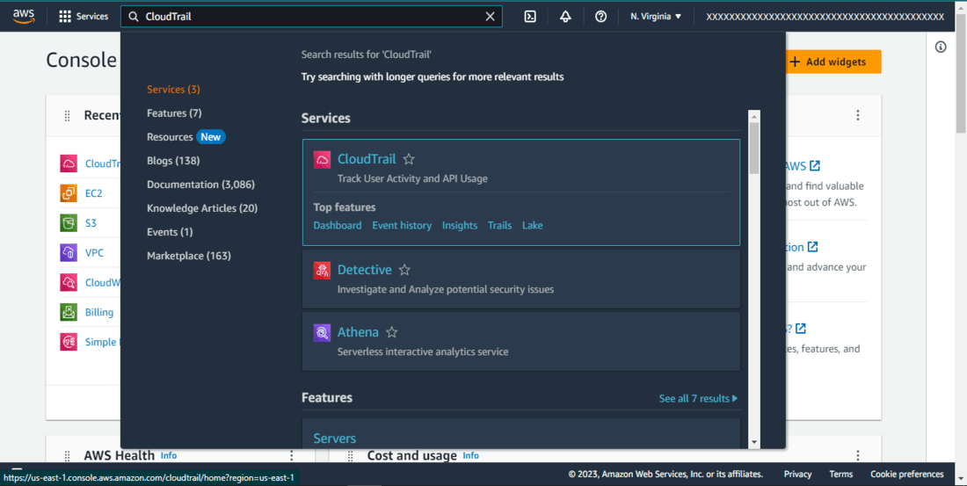
Steps to create cloud trail
Step 1: Go to the Amazon web services Sign-In console. Create an AWS Free Tier Account.
Step 2: Try signing in with your root username and password
Step 3: Click on Services and search for “CloudTrail”.

Slide 17
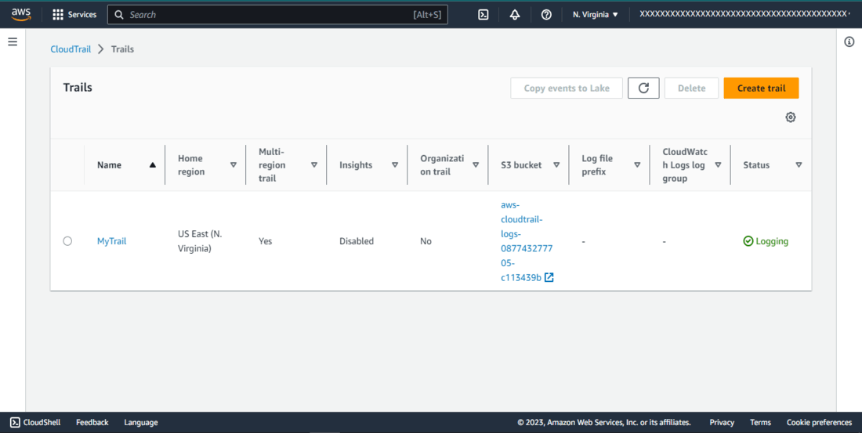
Step 4: Create CloudTrail
Select “Create CloudTrail”, name it as “MyTrail”.

Slide 18
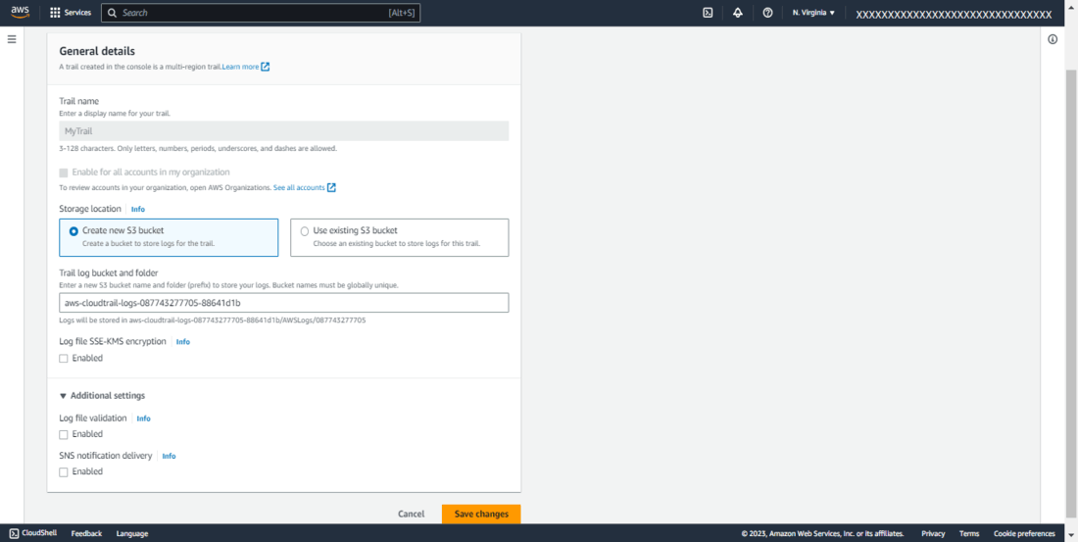
Step 5: Edit Storage Location
Click on the created “MyTrail” and edit the storage location. Choose “Create new S3 bucket” and save changes.

Slide 19
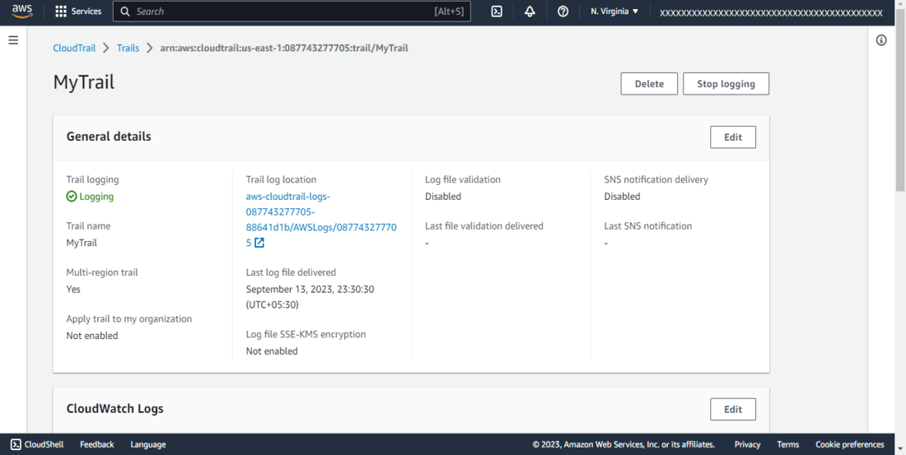
Step 6: Save Changes
Confirm and save changes to finalize the S3 bucket configuration.

Slide 20
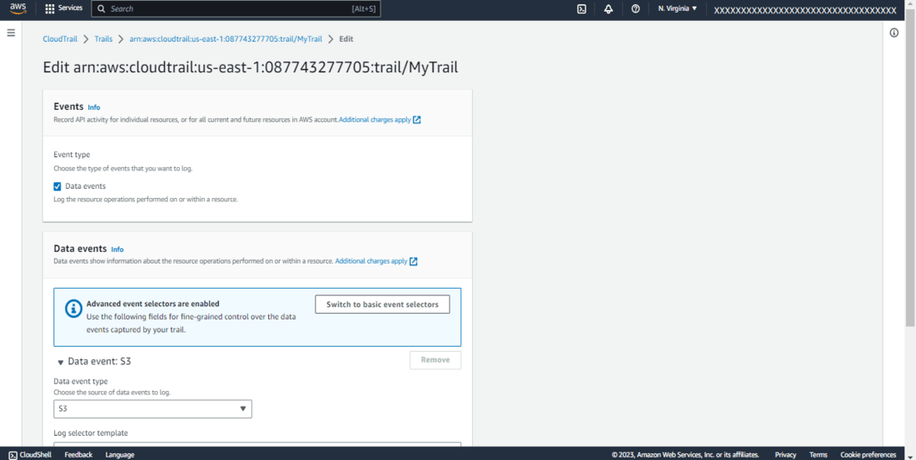
Step 8: Confirm Settings
Ensure data events are configured to deliver to the AWS CloudTrail console, Amazon S3 buckets, and optionally Amazon CloudWatch Logs.

Slide 21
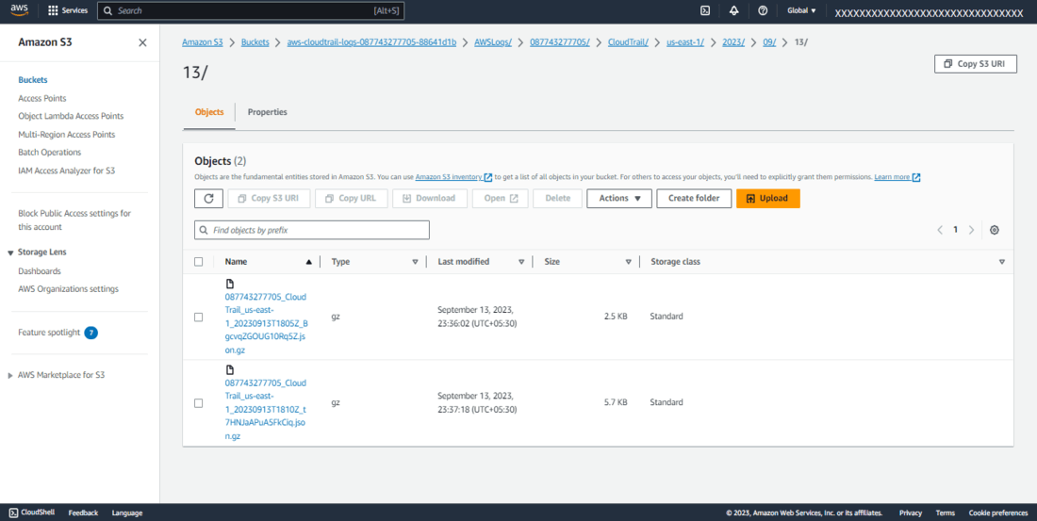
Step 9: Monitor Data Events
Data events are automatically stored in the designated S3 bucket.
Step 10: Access and Review Event Data
Navigate to the S3 bucket, locate the first file, download it, and review the JSON formatted data events.

Slide 22
CloudWatch
Amazon CloudWatch is a monitoring and observability service that provides data and insights to monitor applications.
Primary features:
CloudWatch Metrics
Graphing Metrics
Metric Math
CloudWatch Logs
CloudWatch Alarms
Notes:
Amazon CloudWatch is a monitoring and observability service that provides data and insights to monitor applications, respond to system-wide performance changes, and optimize resource use. Here’s a look at its primary features:
1. CloudWatch Metrics
Metrics are the data points collected from AWS resources and applications.
Each AWS service provides default metrics, like CPU utilization for EC2 instances, request counts for API Gateway, etc.
You can also create custom metrics by sending data from your applications.
Metrics are organized by namespace and dimension, helping to categorize and filter data for more granular monitoring.
2. Graphing Metrics
CloudWatch allows you to create visualizations of metrics using the CloudWatch Console.
Dashboards enable you to create custom views with graphs for multiple metrics across services, regions, and accounts.
Graphs support various types, like line graphs, stacked areas, and bar charts, which help in identifying trends and patterns over time.
3. Metric Math
Metric Math allows you to perform calculations on CloudWatch metrics to gain more insights.
You can apply mathematical functions like sum, average, min, max, or percentile to one or more metrics.
Useful for creating derived metrics (e.g., calculating the error rate by dividing error count by request count) and analyzing complex scenarios in real time.
4. CloudWatch Logs
CloudWatch Logs enables you to collect, monitor, and analyze log data from AWS resources and applications.
Log groups organize log events, and log streams hold sequences of log events from the same source.
CloudWatch Logs offers Log Insights, a powerful query language to search and analyze log data.
Supports retention policies for how long to keep logs and integrates with Lambda for automated responses based on log patterns.
5. CloudWatch Alarms
CloudWatch Alarms help you set thresholds on metrics to trigger alerts or automated actions.
Supports various conditions (e.g., alarm state for threshold breach, OK state, insufficient data state).
Actions on alarms include sending SNS notifications or triggering Auto Scaling or EC2 recovery actions.
Alarms can be static (set value thresholds) or anomaly detection-based, where CloudWatch dynamically adjusts based on historical data patterns.

Slide 23
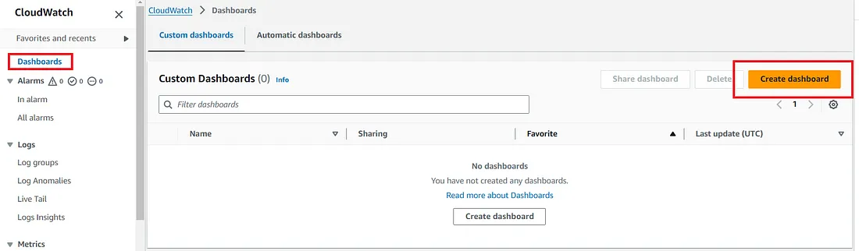
Creating Custom Metrics and Dashboards for AWS Resource Monitoring
Navigate to CloudWatch in the AWS Management Console.
Select “Dashboards” from the sidebar.
Click “Create dashboard”.
Enter a name for your dashboard.
Add widgets such as graphs, numbers, and text, selecting the metrics you want to display.

Slide 24
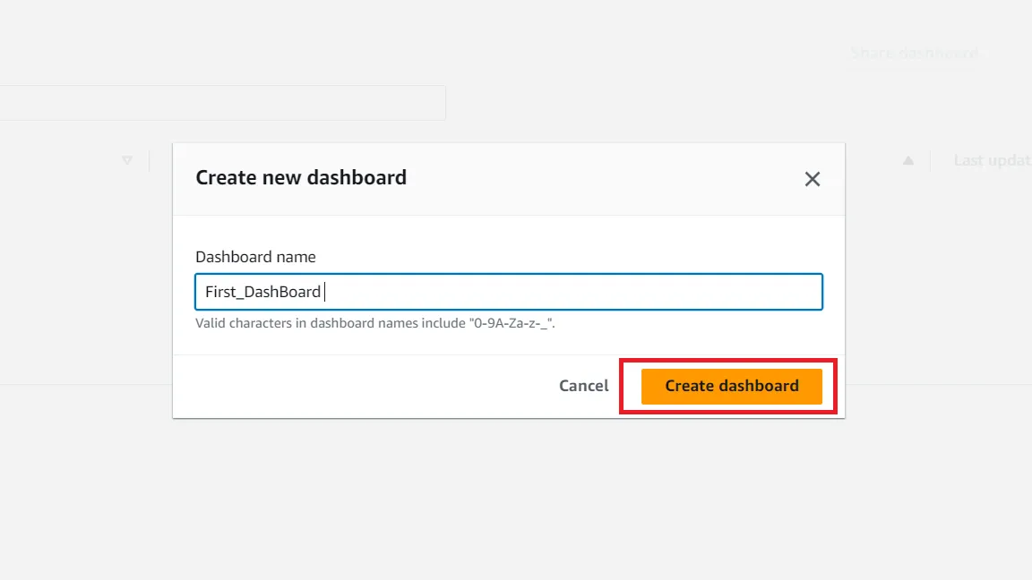
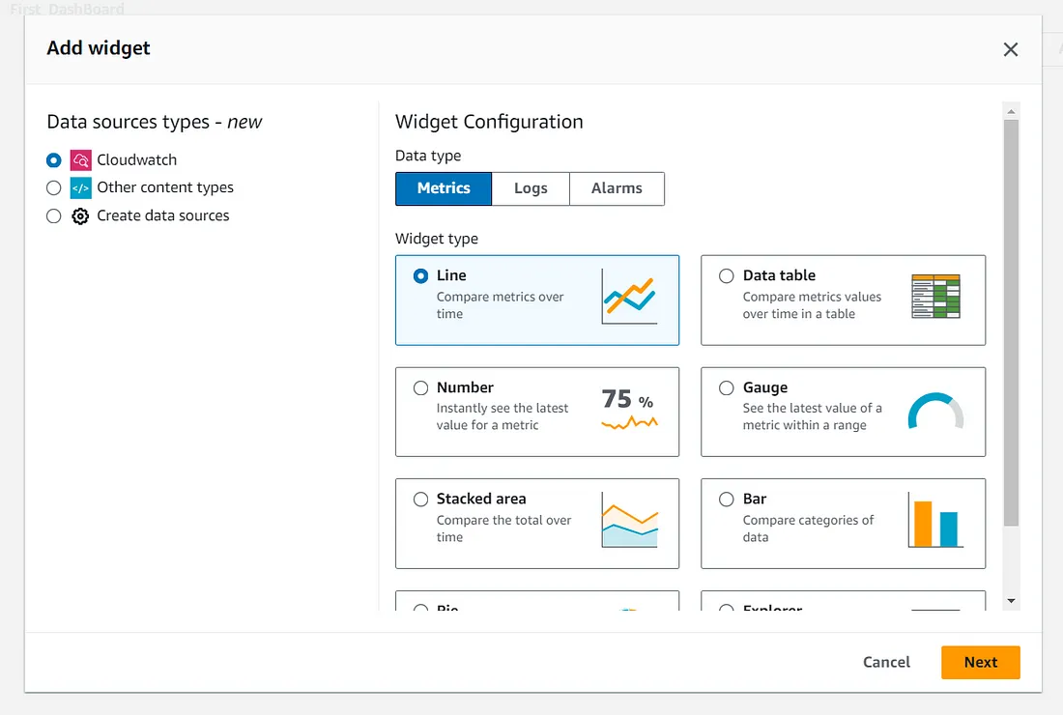

Slide 25
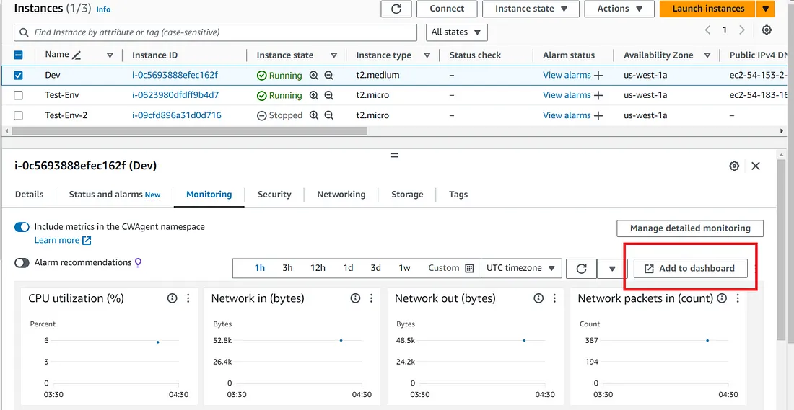
You can also add the metrics from dashboard or you can add it from ec2 or other resources.

Slide 26
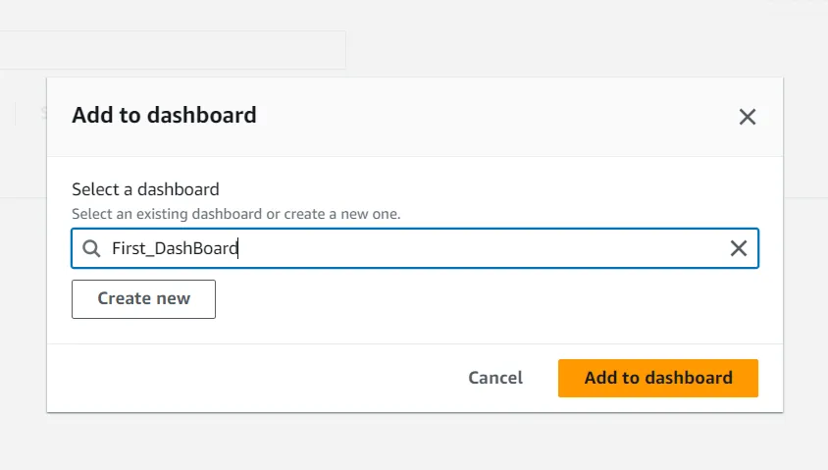
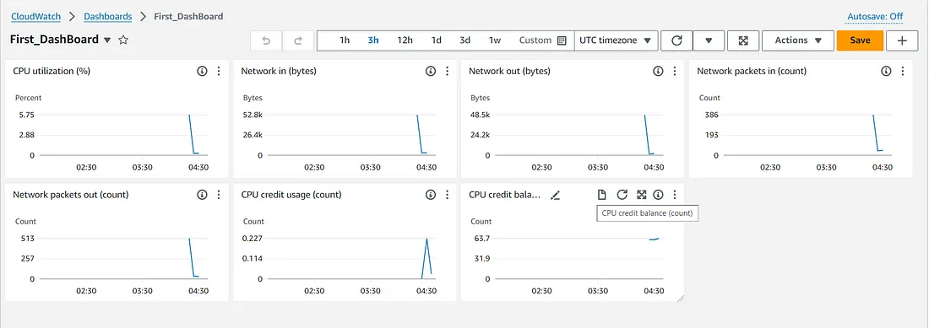
Vn

Slide 27
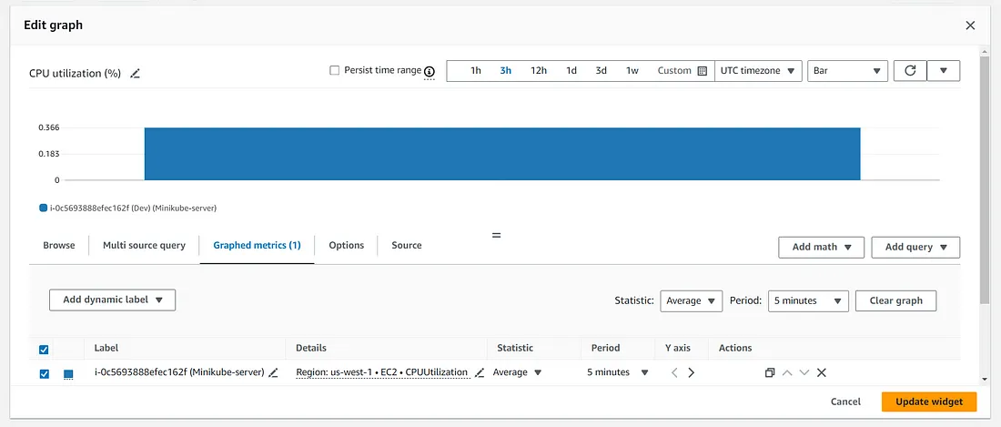
All the metrics have been added in your dashboard. Now we can customize their appearances.

Slide 28
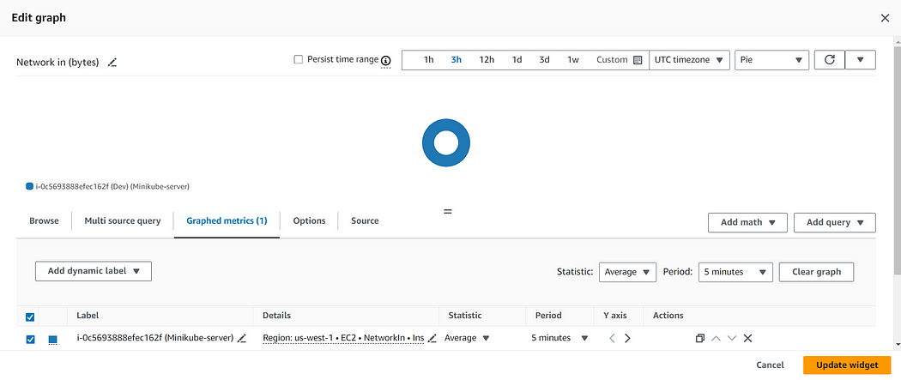

Slide 29
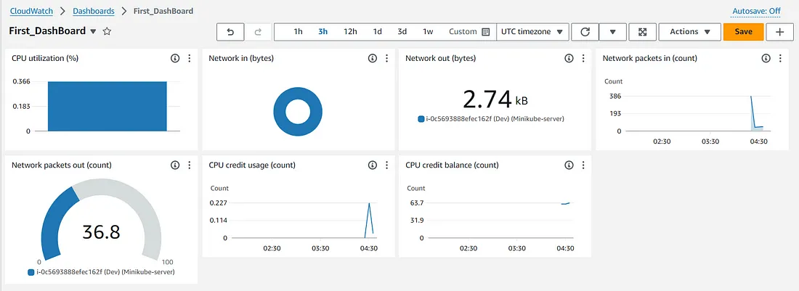
This visual representation helps in understanding the health and performance of your applications at a glance.

Slide 30
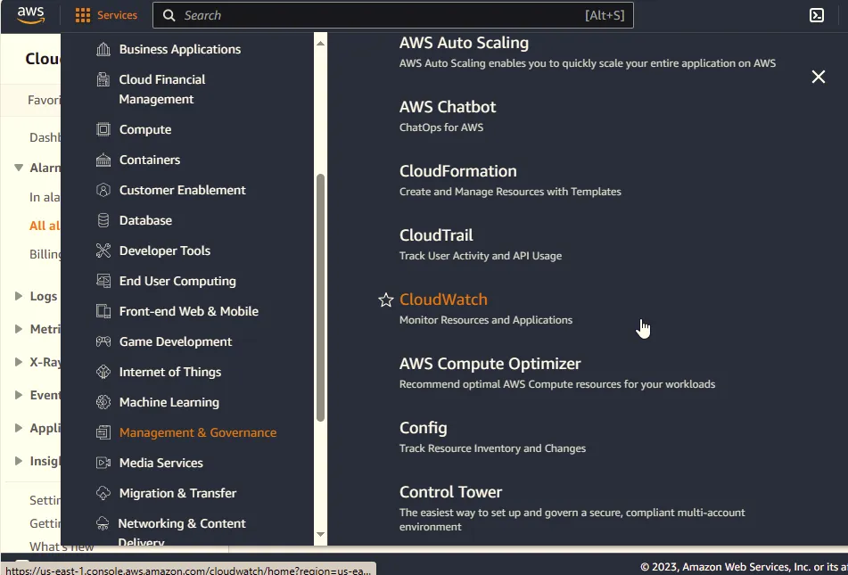
Creating CloudWatch Alarms
Access the AWS Management Console:
Open your web browser and navigate to AWS Management Console.
Log in to your AWS account.
2. Go to CloudWatch:
In the AWS Management Console, locate and click on “Services” in the top left corner.
Under “Management & Governance,” select “CloudWatch.”

Slide 31
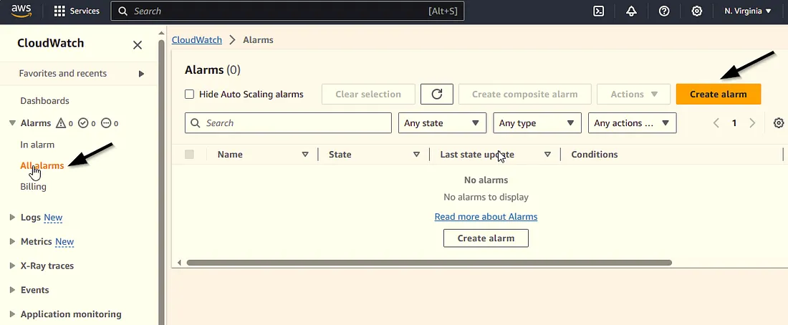
3. Navigate to Alarms:
In the CloudWatch dashboard, find the left-hand navigation pane.
Click on “Alarms” under the “All arms” section.
On the “All alarms” page, click the “Create Alarm” button.

Slide 32
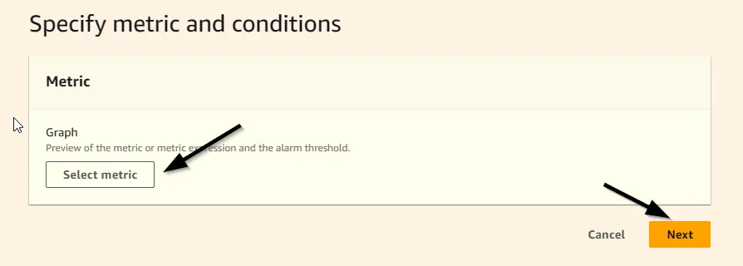
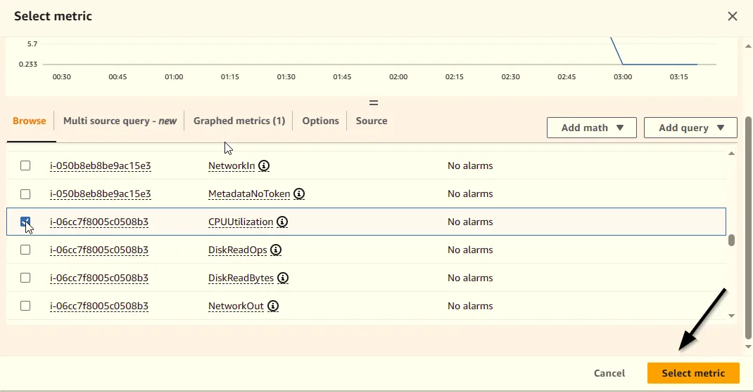
4. Select Metric:
Choose the metric you want to monitor by selecting a data source (e.g., EC2, RDS) or a custom metric.
Here we can select our ec2 preferred conditions
Here we selecting “CPU utilization”
And click “select metric”

Slide 33
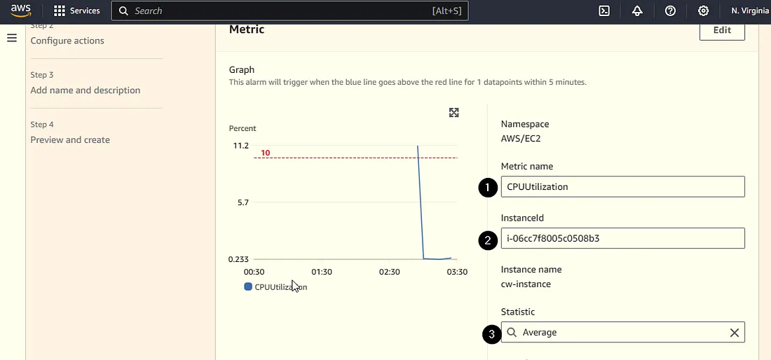
5. Define Conditions:
Set conditions for the alarm. Specify thresholds, comparison operators, and evaluation periods.
we can set conditions according to our requirements.

Slide 34
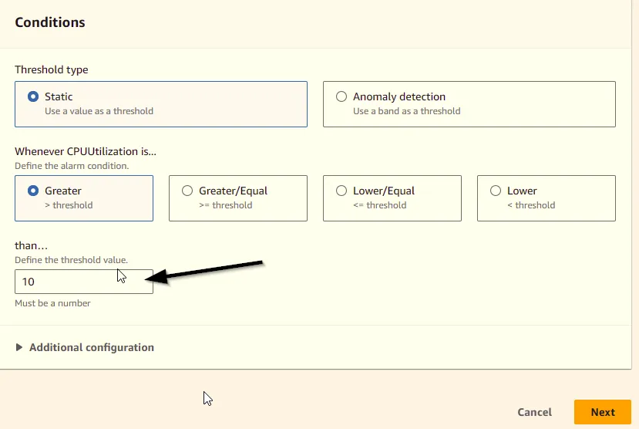
In the define threshold value section we can make different value with our own requirement
Click next to continue

Slide 35
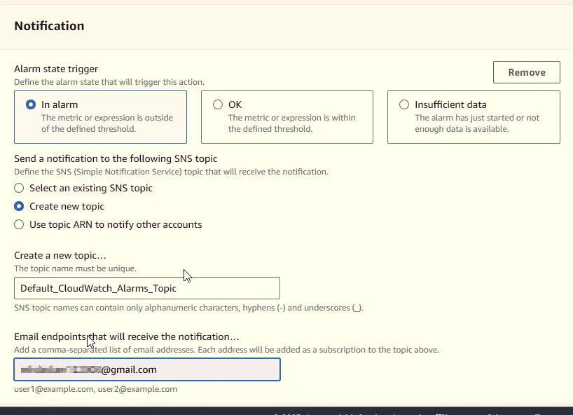
6. Set Actions on configure SNS topic
Choose “Create a new SNS topic.”
Enter a name for the new SNS topic.
Enter E-mail as a end point
click create topic

Slide 36
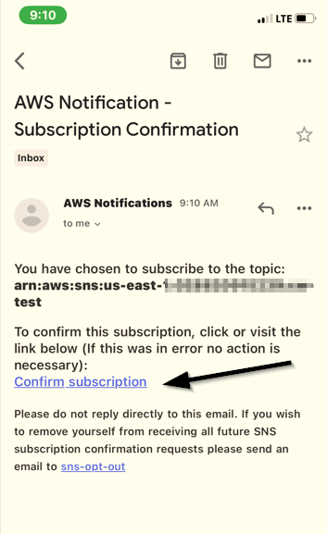
After creating sns topic aws sends you a conformation mail for the Gmail address given
Click the confirm subscription

Slide 37
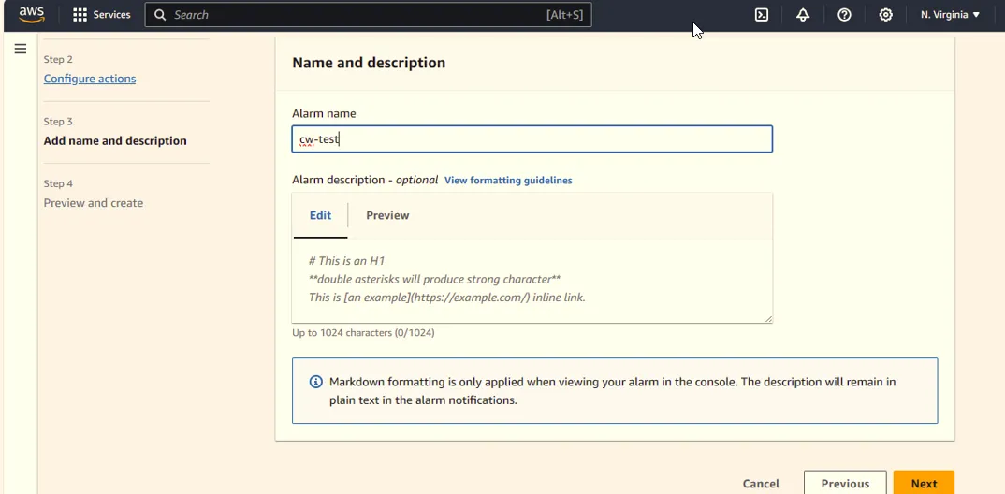
Add Name and Description:
Provide a meaningful name and description for your alarm to easily identify its purpose.

Slide 38
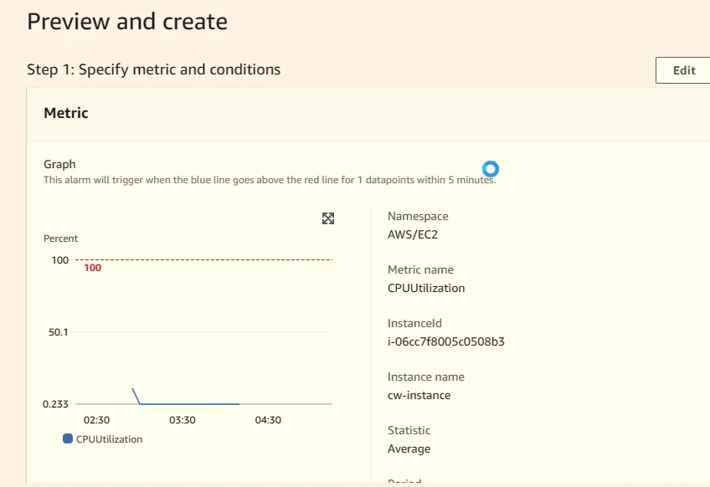
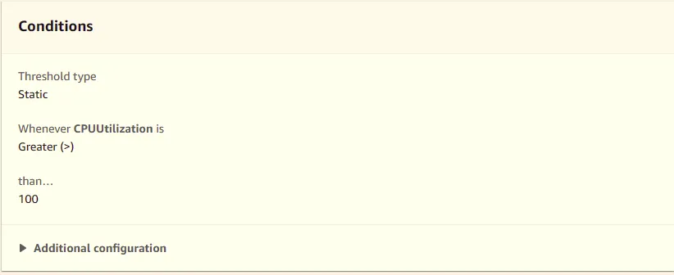
3. Review and Create:
Review your configuration to ensure it meets your requirements.
Here we can review the conditions what we give

Slide 39
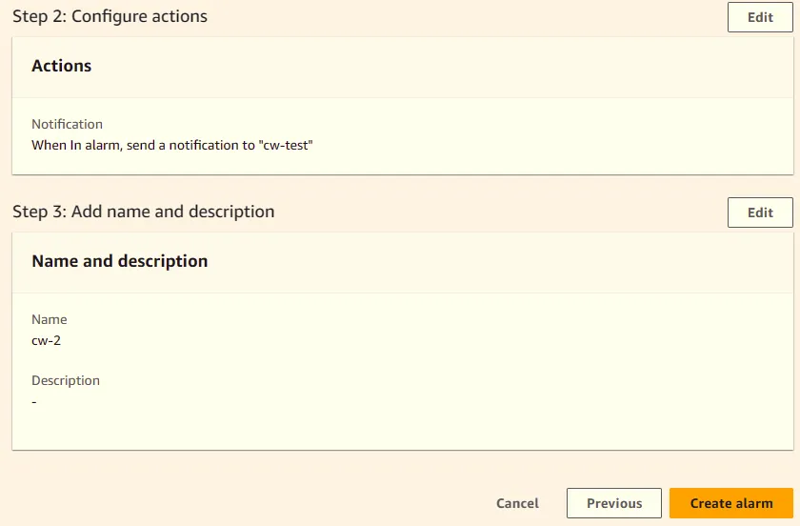
Click “Create Alarm” to finalize the alarm setup.
If the CPU utilization become more than what we give the value we get an message to our required mail address

Slide 40
THANK YOU

